Slide 1
Revisiting the History of Subsurface Wastewater Disposal (SSWD) Systems In Maine
February 27, 2024
Don Hoxie, AL Frick, Clough toppan, gene moreau, ken stratton

Slide 2
Division of Environmental Health's Timeline
In the 1920’s typhoid outbreaks along Maine rivers caused the Legislature to create a Division of Sanitary Engineering within the Maine Bureau of Health.
In 1974 the name was changed to the Division of Health Engineering still in the Maine Bureau of Health.
In 2008 the name was changed to the Division of Environmental Health in the Maine’s Center of Disease Control.
Besides responsible for the SSDW Code, it continues to regulate public water supplies, license eating and lodging establishments, regulate radiation devices and radionuclide use, plus regulating several other environmental health related programs.

Slide 3
In 1950s and 1970s the Division was a very unusual state agency and very lucky.
It had a unique staff (other than clerical), of chemists, biologists, sanitarians, professional engineers (sanitary and chemical), and master plumbers, and one Chiropractor.
It was in a very large Department (Health and Welfare) that did not know or care about what it was doing.
Though the years it had been used by the Maine’s legislature as in incubator of a variety of health and environmental programs.
It had no oversite Board, and, during those years, it reported directly to the Commissioner who besides being an MD had a BS in engineering.

Slide 4
The Early SSWD Code’s Timeline
1920 the Maine “Plumbing Code,” was adopted addressing indoor plumbing but not SSWD systems.
1926 the Plumbing Code required connecting to a cesspool if a public sewer was not available.
1945, the Plumbing Code added a new paragraph 122 addressing other types of SSWD systems for the first time.
1946 Cesspools were prohibited sites where the groundwater table is less than four (4) feet from the surface.

Slide 6
The Maine Plumbing Code’s Original Single SSWD Paragraph
It sized SSWD systems based on the verbiage sand, loam, or clay.
Only inverted notched wooden plank and clay pipe trenches were permitted.
Most of the trench systems ended up being 50 feet long.
Most of the wastewater ended up in cesspools

Slide 7
Notches

Slide 8
Clay Tile Disposal Fields
Tar Paper
Clay Tile
Clay Tile

Slide 9
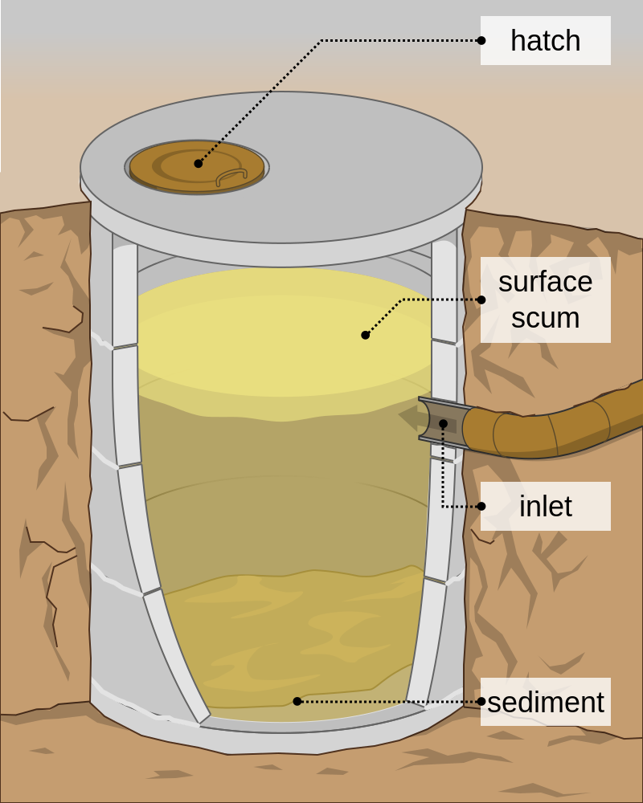
Most SSWD systems discharged directly to cesspools or leaching pits.

Slide 10
In the 1960s The Plumbing Code’s Article 11, Paragraph 122 was greatly expanded
I want you to think about Dealing With some of Article 11’s Requirements today

Slide 11
Percolation (Perc) Tests Were Required
Perc Tests had to be supervised by professional engineers, land surveyors, or master plumbers
Small dwellings required 4 perc tests
Other structures required 6 perc tests for the first 1,000 gpd and an additional one perc test for each 1,000 gpd after the first six.

Slide 12
Trench Sizing for One- and Two-Family Dwellings
 | Year-Round Use |  | Summer Only
Perc Rate in Min/inch | Two Bedrooms or Less | Each Additional Bedroom | Two Bedrooms or Less | Each Additional Bedroom
5 or less | 83 ft | 42 ft | 50 ft | 25 ft
10 | 115 ft | 55 ft | 67 ft | 33 ft
15 | 127 ft | 64 ft | 77 ft | 38 ft
30 | 167 ft | 84 ft | 100 ft | 50 ft
45 | 200 ft | 100 ft | 120 ft | 60 ft
60 | Unsuitable | Unsuitable | 133 ft | 67 ft
Over 60 | Unsuitable | Unsuitable | Unsuitable | Unsuitable

Slide 13
Maximum Side-Wall Loading Rates for Other Types of Structures
Perc Rate in Min/inch | SQ. Ft./GPD | SQ. Ft./GPD With Garbage Grinder | SQ. Ft./GPD With Automatic Washer | SQ. Ft./GPD With both GG & AW
5 or less | 0.45 | 0.54 | 0.63 | 0.72
10 | 0.63 | 0.76 | 0.88 | 1.01
15 | 0.78 | 0.94 | 1.09 | 1.25
30 | 1.10 | 1.32 | 1.54 | 1.76
Soil Suitable for Summer Use Only
45 | 1.34 | 1.61 | 1.88 | 2.15
60 | 1.55 | 1.86 | 2.17 | 2.48
Over 60 | Unsuitable For Subsurface Disposal

Slide 14
Groundwater Was Addressed For The First Time
The bottom of the SSWD systems had to be at less 24 inches above maximum ground water table, bedrock, or impervious strata.
The maximum groundwater table had to be determined during the time of year when ground water was at its highest elevation.
The maximum groundwater data published by the U.S. Department of Agriculture; Soil Conservation Service could be used if the soil profit’s name was known.
Think about it. To meet this requirement, the typical engineer, land surveyor, or master plumber had to dig exploratory holes in the spring or late fall.

Slide 15
Maximum Slope of Disposal Site
SWDS systems could not be installed if the site sloped more than 12%.
12 feet
100 feet

Slide 16
Man-Made Areas
There was a lot of requirements concerning man-make areas:
Fill must extend at least 25 feet beyond the disposal bed.
The fill must slope at a maximum of 10% to the original ground.
The fill material must have similar perc rates and soil characteristics and the ground below it.
The original ground surface must be scarified before placing the fill.
The fill must be mechanically or hydraulically compacted in 8-inch layers or allowed to settle for at least 6 months
How would you like to ensure your man-make site met this criteria?

Slide 17
Disposal Trench Requirements
Maximum No. in field if trenches >100-ft | 2
Maximum length of trench | 100 ft
Minimum length of trench | 60 ft
Minimum width of trench bottom | 2 feet
Minimum diameter of distribution pipe | 4 inches
Maximum slope of distribution pipe | 2 inch in 100 Feet
Minimum distance of undisturbed soil between trenches | 10 feet
Maximum depth of bottom of distribution pipe | 18 inches
Maximum depth of top of distribution pipe | 10 inches
Maximum depth of stones below distribution pipe. | 18 inches

Slide 18
Distribution Boxes Required
If there was more then one trench a distribution box was required.
Serial distribution was prohibited.
Trench
D-Box
Trench
Trench

Slide 19
Venting and Dosing Required
All SSWD systems receiving more than 2,000 gal/day required screened vents down-stream of the trenches.
All SSWD systems with greater than 500 linear feet of trench required dosing tanks, which must:
Equally distribute the wastewater to all parts of the SSWD system.
Distribute at intervals not less than 2 hours.
Have a dosing capacity equivalent to 75% of the interior volume of the percolation pipes.

Slide 21
Septic Tank Sizing
Septic Tanks for one- and two-family dwellings
Septic Tanks for other structures were sized on 1.5 times the daily estimated flows or 750 gallons which ever was larger.
No. of Bedrooms | Gallon Capacity
2 or less | 750
3 | 500
4 | 1000
Each additional bedroom added | 250

Slide 22
Detailed Requirements Concerning Septic Tanks
Liquid Depth – Must be at least 30 inches deep.
Inlet Baffles and Tees – Must extend below the liquid level at least 6 inches.
Outlet baffles and Tees – Must extend below the liquid level a distance equal to 40% of tanks liquid depth.
Both inlet and outlet baffles and tees must extend to approximately one inch of the top of tank.
Design requirements for septic tanks with multiple compartments.
How to install multiple septic tanks in series.

Slide 23
Set Back Requirements in Feet
Features | < 2,000 GPD SWDS |  | > 2,000 GPD SWDS
 | Septic Tank | Disposal Field | Septic Tank | Disposal Field
Property Lines | 10 | 10 | 20 | 20
Buildings | 8 | 20 | 20 | 40
High water mark of freshwater | 100 | 100 | 100 | 300
High water mark of tide water | 60 | 60 | 100 | 100
Wells and springs delivering <2,000 g/d | 100 | 100 | 100 | 300
Wells and springs delivering >2,000 g/d | 100 | 300 | 100 | 300
Downhill slopes steeper than 33% |  | 50 |  | 50

Slide 24
Engineered Plans Required
SSWD systems designed to treat more than 2,000 gallons per day and commercial and self-service laundries required:
Plans prepared by a professional engineer, and Bureau of Health for review and approval.
Perc tests had to be submitted to the local plumbing inspector to get a permit.
Article 11 did not say who was responsible for designing SSWD systems treating under 2,000 gallons per day.
There was nothing like today’s HHE-200 form required.
It appears that the contractor and local plumbing inspector were responsible to ensure that all Article 11’s requirements were met.

Slide 25
Did You Notice That Article 11?
Is the reason for the RULES FOR CONVERSION OF SEASONAL DWELLING UNITS INTO YEARROUND RESIDENCES IN THE SHORELAND.

Slide 26
Volumes of Wastewater
There was an Appendix C of “expected daily quantities of sewage per unit of contributary population.”
Think about what has happen to wastewater volumes since the 1974 code was initially adopted and its impact on indoor plumbing and the pollutant load of the wastewater stream entering today’s SSWD systems.
Plumbing Fixture | In 1974 | Today
Water Closets | 7 gal/flush | 1.5 gal/flush
Washing Machines | 40-45 gal/load | 10-25 gal/load
Shower Heads | 5 gal/min | 2 gal/min
Dish Washers | 9-14 gal/load | 4 gal/load

Slide 27
Enough about Article 11
Now Let’s Discuss the background behind today's code

Slide 29
The Origin of Percolation Tests
The percolation test that the USPHS “Manual of Septic Tank Practice" used for sizing disposal areas came from study conducted by a State Engineer in upper-state New York.
He performed what he called percolation tests (Perc tests) on appropriately 20 existing systems where he attempted to estimate past wastewater volumes, disposal field sizes, and past performance.
It is interesting to note that his Perc tests were made using 12 by 12-inch holes not 6-inch holes the USPHS used in its “Manual of Septic Tank Practice.” .

Slide 30
To Properly Perform a USPHS Perc Test You Had To:
Dig a 3-foot deep 6-inch hole.
Scape the side walls of the hole to prevent smearing
Place two inches of gravel in the bottom of the hole.
Figure out how get the water necessary to keep the hole full of water all night.
Come back the next day and adjust the water height until it is 12 inches over the gravel.
Then stand around and wait until the water to drop one-inch and then record the time it took drop the inch.

Slide 31
Problems Associated with Perc Tests
Perc tests were difficult to impossible to perform in the winter or in the spring in soils with high water table.
Both the size of the perc hole and the depth of water in hole made a significant difference in the test results.
Most Perc tests were performed between July and October.
A study of multiple Perc tests performed at a site with uniform soil profile conditions found that at least 30 Perc holes were required to be statistically certain the true results are within plus or minus 5 min/in.
Then remember – The perc rates used to size systems were 5, 10, 15, 30, 45, and 60 min/in.

Slide 32
Additional Problems
Only master plumbers and professional engineers and land surveyors were permitted to perform Perc tests. None had any formal training in the correct way to perform perc tests.
It is estimated the 98+ percent of the Perc tests were performed by master plumbers.
Farmers Home Administration (FmHA) and other home lenders started to insist on Perc tests were conducted in the presence of a State inspector. Fortunately, for the Division engineering staff, Fred Jagels, who worked for the FmHA, did the inspections that FmHA required.
Clough Toppan initially spend a lot of time dealing with perc test problems. He talk about that later.

Slide 33
Article 11’s Major Problem Was
It limited year-round SSWD systems to sites where Perc test results were less than 45-min/in.
Newly published U.S. Soil Conversation fact sheets, indicated that a large percentage of State had soils with percolation rates unsuitable for SSWD systems.
Suitability For SSWD Systems | Percent of The Mapped State
Good | 8%
Fair | 3%
Poor and Very Poor | 89%

Slide 34
For Example
Clay soils typically have Perc tests results ranging up to 120-Minutes/inch.
Unfortunately, the clay deposits occur along coast and up the major river valleys where Maine’s highest population density occurs.

Slide 35
Soil Suitable Maps Were Becoming Available
This is a typical example of a Typical Maine Town (i.e. Lamoine showing Suitability Rating utilizing septic systems with the perc test.
Red = Poor & Very Poor
Pink = Fair
Soil Potential Rating For Land Use Planning at a Local Level in Maine . Maine Agricultural Experiment Station , R. V. Rourke , A. Frick , W. L. Mitchell , 1977

Slide 36
New Laws in The 1960’S
Starting in the 1960’s many new State and federal environment laws were being enacted that were impacted by SSWD systems.
Examples:
At the Federal level – The SSWD responsibilities of the U.S. Public Heath Service were transferred to the newly established EPA.
At the State level -- DEP, the minimum lot size law, Land Use & Zoning Ordinances.
At the Local level – City/Town, subdivision ordinances, etc.

Slide 37
What to Do?
By 1972, it became evident that the existing SSWD paragraphs in that Article 11, paragraph 122 did not address some of the problems caused by these emerging laws.
There was no Federal guidance other than the USPHS’s “Manual of Septic Tank Practice” which many States were continuing to use as the basis for their SSWD rules
Even though Maine was experiencing problems with percolation tests, politically the safest and easiest thing to have done was to simply adopt the USPHS “Manual of Septic Tank Practice” .

Slide 38
About this Time
EPA, looking for alternatives to overboard discharges, was funding Universities and others to study methods and the problems associated with on-site wastewater disposal.
The University of Wisconsin report “ On-Site Wastewater Disposal” funded by EPA, provided much needed data on commercial wastewater volumes.
U.S. Soil Conservation Service (SCS) had recently mapped most of the populated areas of the state and had published data sheets with the following info: 1) geologic origin, 2) soil texture, 3) soil structure, 4) permeability rates, 5) seasonal water tables, and 6) impermeable layers.

Slide 39
At The Same Time
A new Ontario study identified presence of bio-mats in disposal beds and discussed shadow effect from stones
Rein Laak at UCONN had just completed a study of the long-term acceptance rates (LTARs) of bio-mats for different soil textures.
Several other studies showed the advantages of special onsite wastewater treatment plants.
The use of disposal beds, concrete leaching chambers, and small home wastewater treatment plants were starting to be approved in other New England States.

Slide 40
In 1972 A Decision was Made
Maine DHE decided to replace the Perc test with some type of soil profile observation – if nothing more than the old sand, loam, and clay verbiage.
Maine DHE decided to use the soil profile descriptions from the USSCS data sheets.
Since bio-mats were not present when USSCS conducted its permeability tests, Maine DHE decided to use Laak’s bio-mat’s long-term acceptance rates (LTARs) to size SSWD Systems.
Clough Toppan was assigned the task of developing a draft for a new SSWD Code.

Slide 41
The First Problem
The NTCS/SCS soil profiles had multiple names depending on their position in the landscape – called soil catena. Below is an example of the glaciomarine catena containing the names in the Scantic Soil Series
(9C) Buxton- Moderately well drained
(9D) Lamoine Somewhat poorly drained
(9E) Scantic Poorly Drained
(9E) Biddeford- Very poorly drained
Soil Series and Table 9-1 Classifications vs their positions in the landscape

Slide 42
The Code’s Soil Profile Table
The UMO’s Department of Plant, Soil and Environmental Sciences was contacted.
Several UMO professors responded and helped condense the 100 plus soil names down into the Soil Profile Table format that exists in today’s code. It should be noted that for first few years the Soil Profile Table contained the NRCS/SCS’s soil profile names.
Several individuals in other State agencies were of great assistance. Ken Stratton with his soils background was one of the most helpful. He will address the nuances with translating Soil Series info to DHE Table 9-I during Q & A.

Slide 43
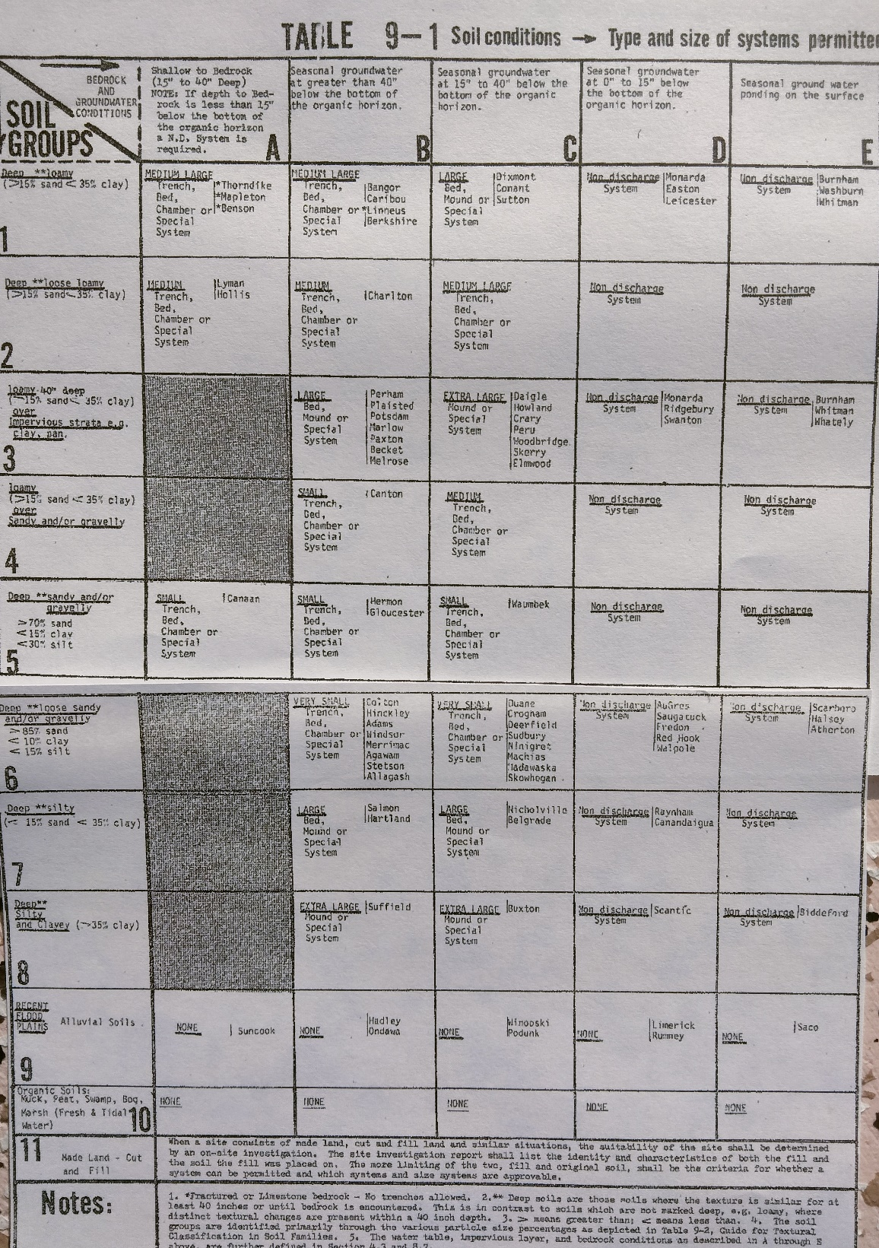
An Early Version of The Table

Slide 44
Others Continued to Assist
UMO provided one-on-one field training for the DHE’s staff in identifying texture, structure, and mottling.
Over the years the Soil Profile Table descriptions were modified by DHE with assistance from MASE TRC.
SCS soil scientists originally served as ‘experts’ for SE field exams and later a group of practicing SEs assisted the State Site Evaluator with establishing field testing acceptable ranges.

Slide 45
The Bio-Mat
As the wastewater from a septic tank is fed into the soil absorption system, a blackish jelly-like Bio-Mat forms on the sides and bottom parts of the leach field.
The Bio-Mat is made up of live and dead anaerobic bacteria and their by-products which attach themselves to the soil particles.
These microorganisms usually rely on the organic matter in the effluent for sustenance and this is why the Bio-Mat is often referred to as the actual site for treatment of effluent.
The bio mat helps to reduce the infiltration rate of water into the soil thereby giving bacteria more time to treat the water before it is released.

Slide 46
1974 - SSWD Code Began Using Laak’s LTARs Instead of Perc Tests
Rein Laak at the Univ. of Connecticut studied the long-term permeability/hydraulic conductivity of loading various soil textures with domestic wastewater.
His study found that different soil textures have different long-term acceptance rates (LTARs).
Believe or not -- clean sands were the Division’s biggest sizing problem.
The Typical
Column Design Used By Laak
Effluent
Biomet
Soil

Slide 47
Laak’s Study Also Found That Bio-mats Can Self-Destruct
Initial acceptance rate
Laak found that bio-mats, after reaching their LTARs, sometimes self-destruct and but never completely return to their original acceptance rate.
New acceptance rate
Self-destructs
GPD/SQF
Long-Term Acceptance Rate (LTAR)
Time

Slide 48
October 1977
EPA published “Alternatives for Small Wastewater Treatment Systems.”
Included in the publication was the work of a group of engineers at University of Wisconsin. They used lab science extensively to get better data on soil absorption.
Their work clarified the roles of hydraulic head and capillary action on different soil textures.

Slide 49
A Lot of Trial and Error
The early days it was a lot of “Trial and Error” and much of it conducted through variances, all of which were willingly financed by the public requesting the variances.
Composting and incinerating toilets to displace water closets.
Gray water systems for laundry machine discharges
Peat filters as pretreatment.
Alternating and resting disposal fields
The use of hydrogen peroxide to destroy existing bio-mats.
The use of lagoons were also considered

Slide 50
Site Evaluator Licensing
The initial 1974 version of the code restricted site evaluations to licensed engineers, soil scientists and geologists.
After several years, the two licensing Boards began battling over who should be allowed to do conduct site evaluations.
Gene Moreau was assigned to work with the Legislature to see what could be done to resolve the problem. I understand that Ken Stratton was also actively involved.
Legislature finally decided that Site Evaluators should be licensed by the Division.

Slide 51
Practical Issues Implementing the SE Licensing and LPI Training
Implementing the SE Program required the writing of a SE Code. Clough Toppan plans to discuss this in Q & A.
It was necessary to get SEs licensed and enforcing the overall program. Gene Moreau plans to discuss this in the Q & A period.
LPI’s were required to be in ALL towns and LURC territory to properly administer the new SSWD Code provisions. Gene Moreau was assigned the responsibility to train LPIs to meet this new responsibilities. Gene Moreau plans to discuss this in the Q & A period.

Slide 52
SSWD System Life Expectancies
In 1985, Al Frick and I presented a paper on Maine’s statewide failure rates. We reviewed 54,000 construction permits and found the following:
More recently, several national studies have shown that SSWD systems typically have a half-life of 26+ years.
Time Period | Number of Failures | Percentage of Failures
After 1 Year | 1 out of 1,000 | 0.1%
After 5 Years | 1 out of 100 | 1%
After 10 Years | 5 out of 100 | 5%

Slide 53
Conclusion
Unfortunately, no scientific study has been done in Maine addressing SSWD longevity since our study in 1985.”
However, it appears that SSWD systems installed properly under Maine’s SE methodology may be having a longevity greater than 26-years providing that the system is: designed, installed, used, and maintained correctly.
Ken, Gene, and Clough will be participating next addressing specific questions in their areas of expertise.
Unfortunately, Al Frick the major contributor and organizer of this presentation is in Florida and couldn’t make it today.

